Slide 1
Optimality and Bifurcations in a Model for Collective Motion
By April Roszkowski
mentor: Prof. Andy Borum, Misha Padidar
Notes:
Collective motion = a number of robots attempting to move in similar ways
Robots in question can be thought of like segways

Slide 2
The problem

Slide 3
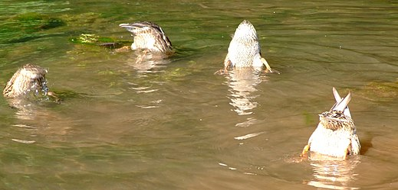
Who cares about collective robotic motion?
Agents copying each other’s behavior arises in nature (allelomimesis—a cool word!)
Most robotic motion planning relies upon agents parsing others’ position or orientation
How can allelomimesis be used in robotic motion planning?

Slide 4








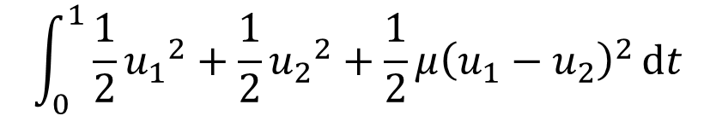


Justh and Krishnaprasad 2015 Model
Coupling constant $μ ε ℝ_{≥0}$
$$\int_{0}^{1}{\frac{1}{2}}{u_{1}}^{2}+\frac{1}{2}{u_{2}}^{2}+\frac{1}{2}μ{\left(u_{1}−u_{2}\right)}^{2}ⅆt$$
minimize
$${\dot{x}}_{1}=\cos\left(x_{3}\right)$$
$${\dot{x}}_{4}=\cos\left(x_{6}\right)$$
$$\vec{x}\left(O\right)={\vec{x}}_{O}$$
subject to
$${\dot{x}}_{2}=\sin\left(x_{3}\right)$$
$${\dot{x}}_{5}=sin\left(x_{6}\right)$$
$$\vec{x}\left(1\right)=\vec{x_{f}}$$
$${\dot{x}}_{3}=u_{1}$$
$${\dot{x}}_{6}=u_{2}$$
$u_{i}$ is the turning rate of robot i
Only studied for coupling of 0 or $∞$!
Notes:
*DRAW MODEL ON BOARD*
Beginning with a model for two robots, can be extended later
Coupling together path curvature

Slide 5
Give us an optimal path for robot 1
Make the two robots’ paths as similar in curvature as the coupling dictates
$$\int_{0}^{1}{\frac{1}{2}}{u_{1}}^{2}+\frac{1}{2}{u_{2}}^{2}+\frac{1}{2}μ{\left(u_{1}−u_{2}\right)}^{2}ⅆt$$
Give us an optimal path for robot 2
Notes:
‘similar’ = ‘close values of curvature’

Slide 6

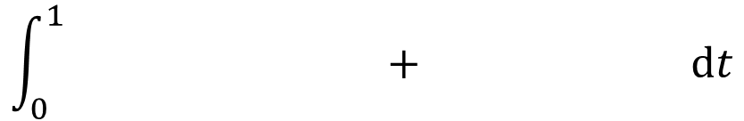

$$\int_{0}^{1}{ + ⅆt}$$
$$\frac{1}{2}{u_{1}}^{2}+\frac{1}{2}{u_{2}}^{2}$$
$$\frac{1}{2}μ{\left(u_{1}−u_{2}\right)}^{2}$$
If $μ$ is small, each robot will act more independently.

Slide 7

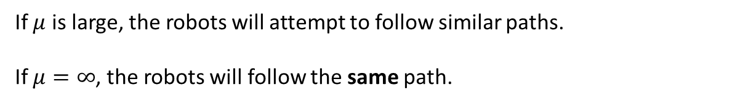

$$\int_{0}^{1}{ + ⅆt}$$
$$\frac{1}{2}μ{\left(u_{1}−u_{2}\right)}^{2}$$
$$\frac{1}{2}{u_{1}}^{2}+\frac{1}{2}{u_{2}}^{2}$$
If $μ$ is large, the robots will attempt to follow similar paths.
If $μ=∞$, the robots will follow the same path.

Slide 8
Canonical solution forms

Slide 9
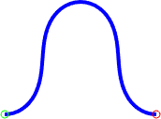
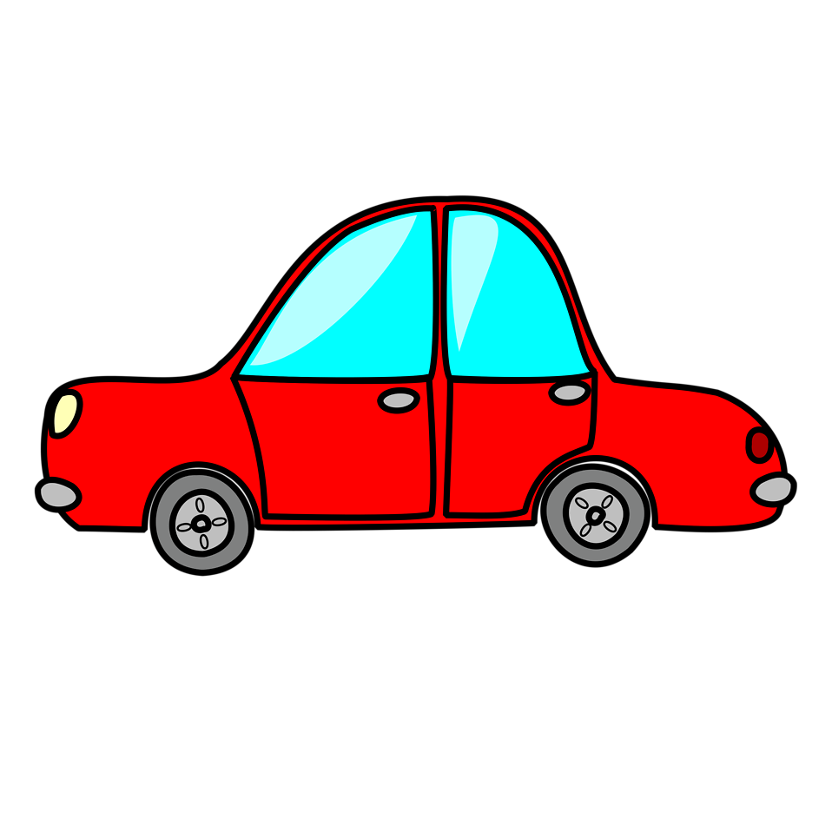


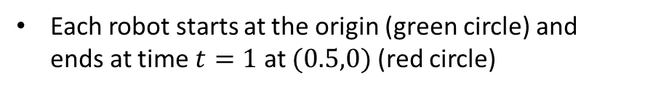
 | Bell 2 inflection points Optimal
 | S shape 3 inflection points Suboptimal
 | Loop 0 inflection points Optimal
Each robot starts at the origin (green circle) and ends at time $t=1$ at $(0.5,0)$ (red circle)
More complex solutions can be described in terms of simple ones (hence, canonical)
Notes:
Arclength is fixed at 1
Robot 1 in blue, robot 2 in red
Canonical forms are shapes that exist when no coupling
Strategy is to combine canonical forms and observe behavior past mu=0

Slide 10

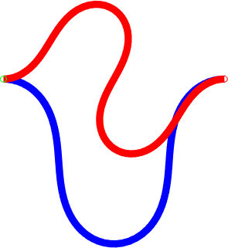

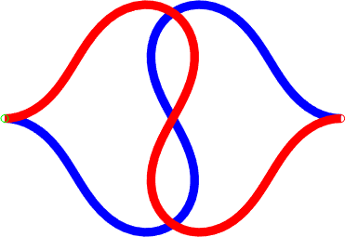
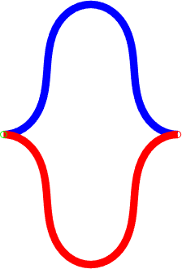

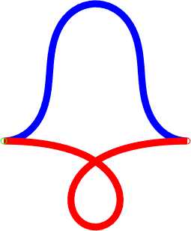
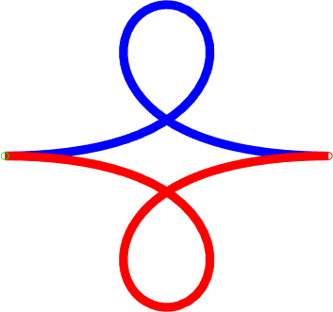


.
.
.
Notes:
End: taking these forms from mu=0 forward… what do we get? Bifurcations!

Slide 11
Bifurcations in the solution space

Slide 12
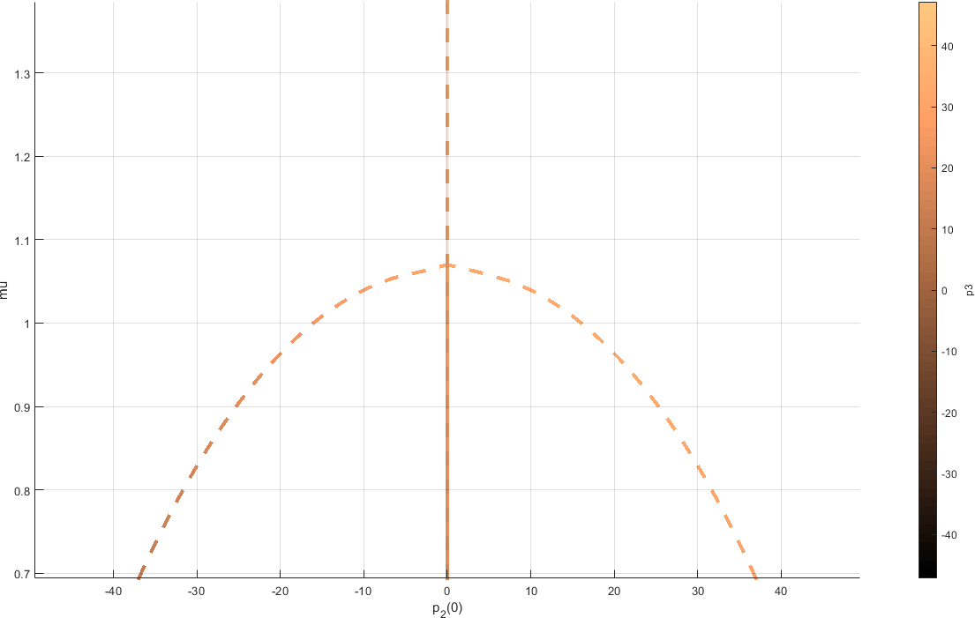
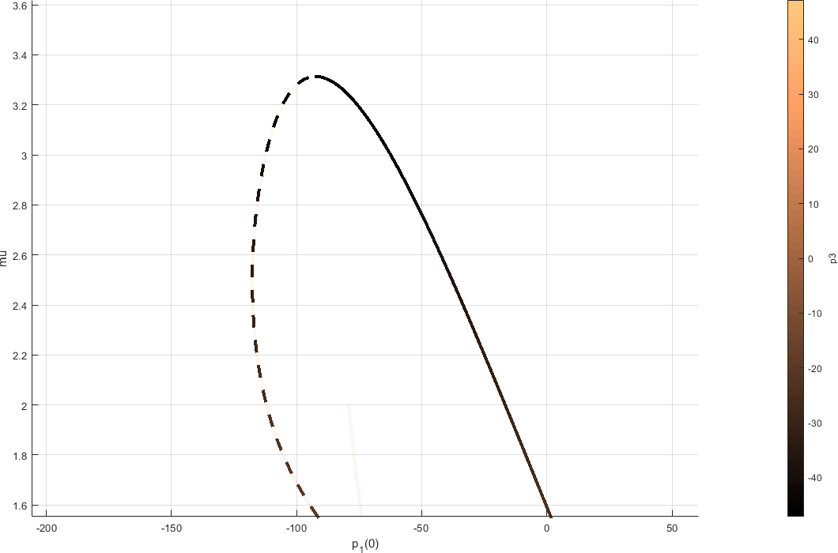
Pitchfork Bifurcation (subcritical)
A suboptimal solution splits off into two suboptimal solutions one optimal solution
Fold (Saddle-node) Bifurcation
Two solutions—one optimal, one suboptimal—collide and obliterate each other
Notes:
Solid/dashed represent optimality

Slide 13
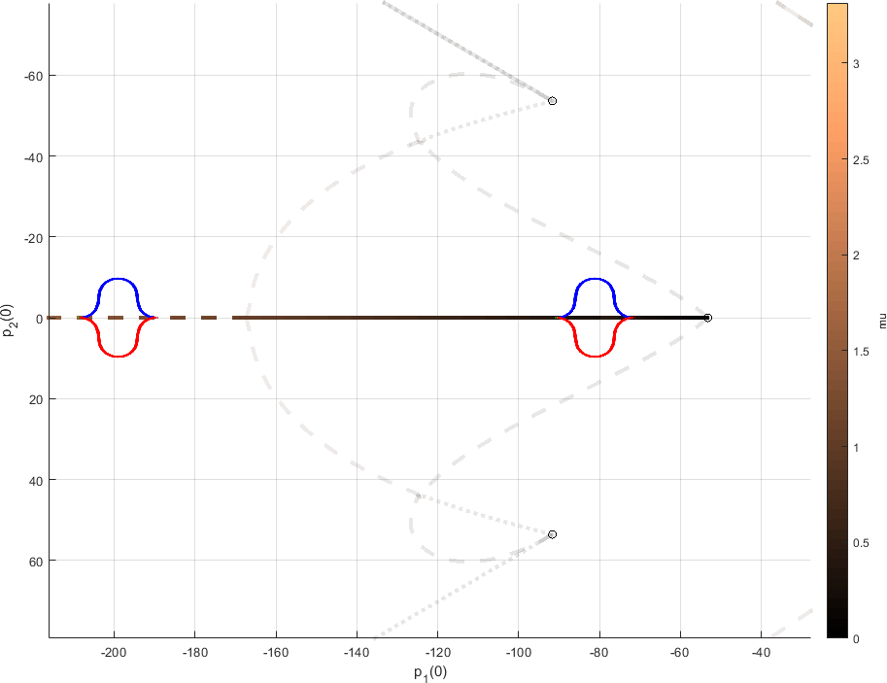
Notes:
Axes are the costate variables (also momenta)—just one unique parameterization of solutions
Mu is the coupling constant, generally increases to the left
Each point represents a solution to our problem at a given coupling value
Mention figures along side
Mention transparent paths
Optimal solution becomes suboptimal as coupling increases

Slide 14
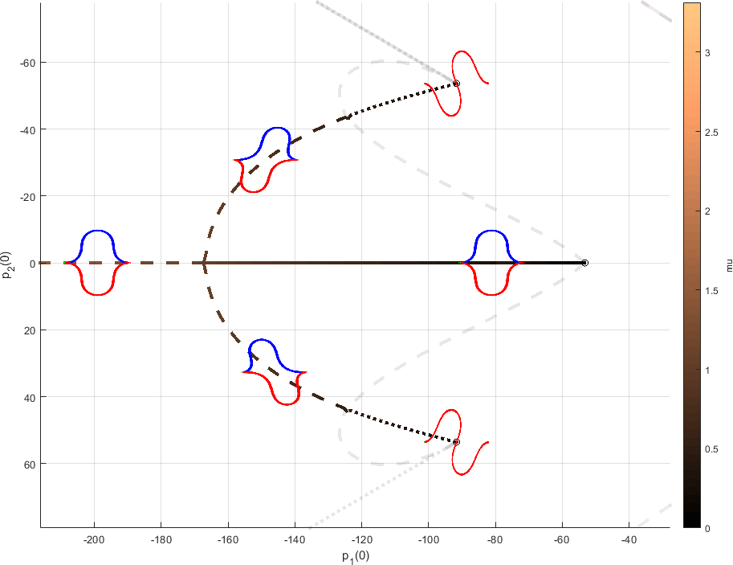
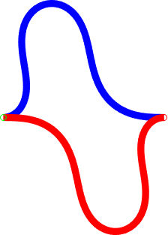
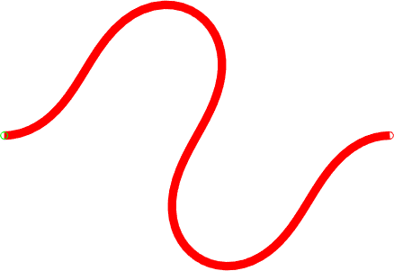
Notes:
We found a side path, which is essentially the double bell but with shear
Mention optimality

Slide 15
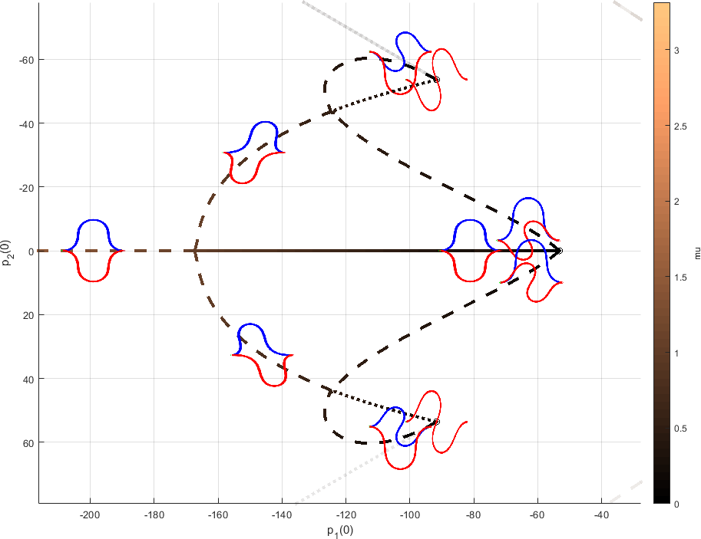
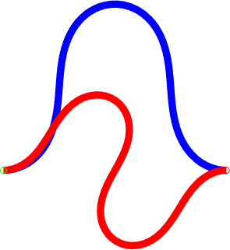
Notes:
Point out that tree is based on robot one having a bell shape
It’s only a visualization in 3 dimensions, while our dataset is 7-dimensional

Slide 16
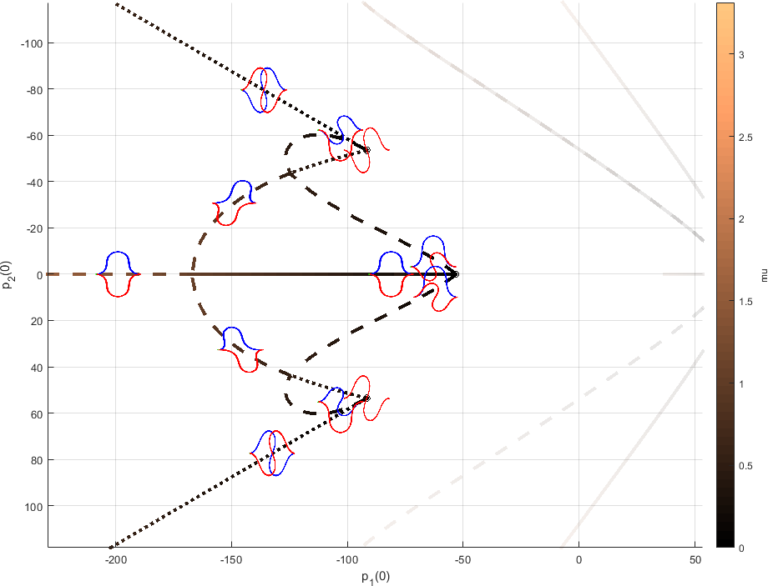
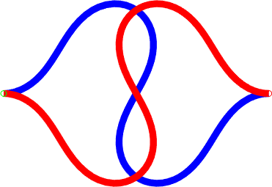
Notes:
Mention e.g. of flipping transform

Slide 17
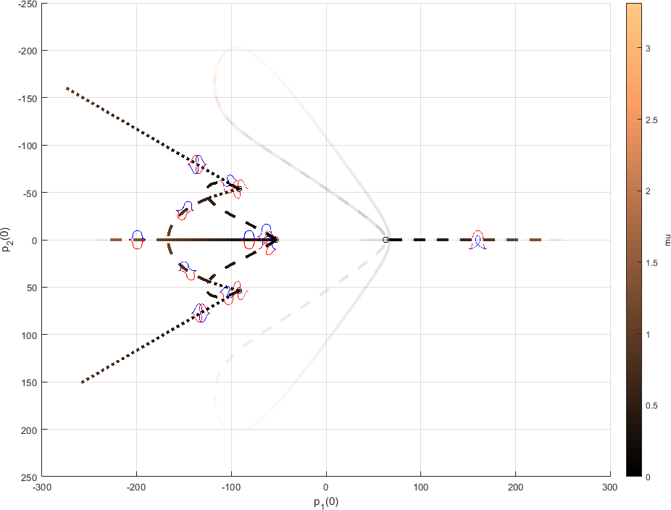
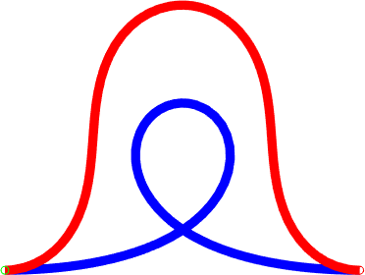
Notes:
Found new tree based on robot one doing a loop

Slide 18
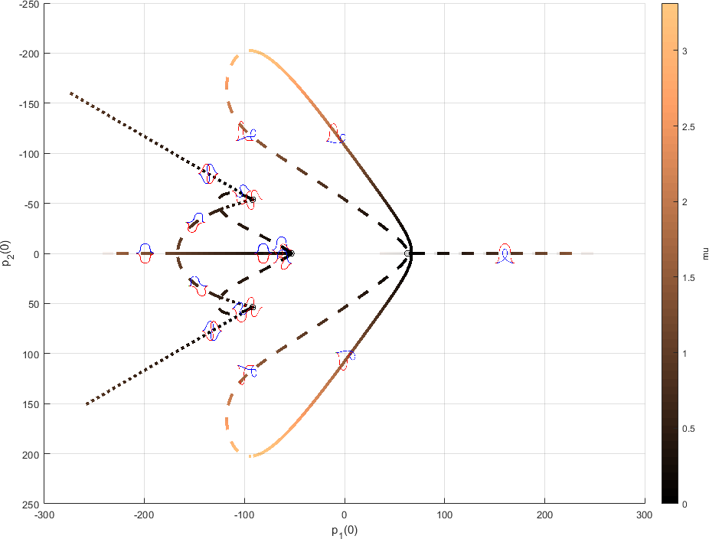
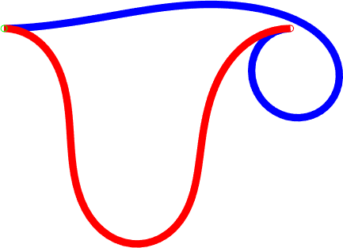
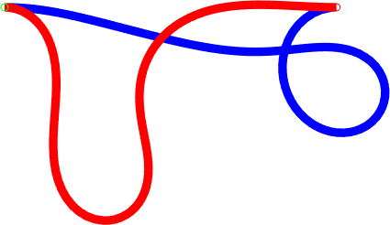
Notes:
Fold bifurcation, more shear
Can see mu coloration here

Slide 19
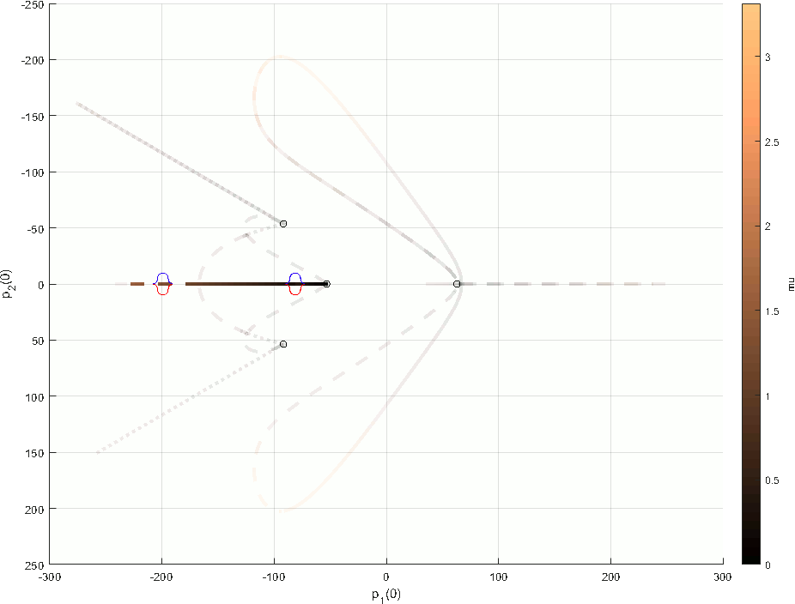
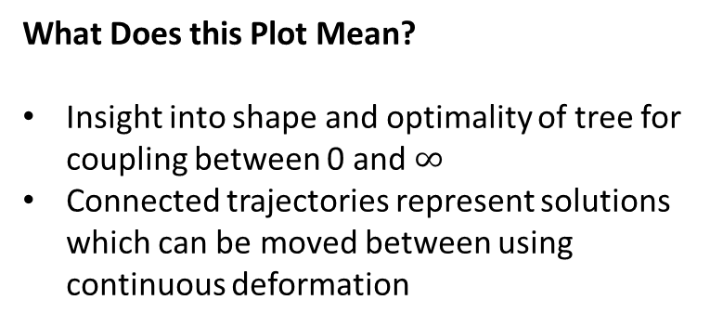
What Does this Plot Mean?
Insight into shape and optimality of tree for coupling between 0 and $∞$
Connected trajectories represent solutions which can be moved between using continuous deformation
Notes:
We only have two (really, three) solutions which are optimal for non-negligible coupling

Slide 20
Recapitulation

Slide 21

Recapitulation
Multiple optimal solutions exist to our problem, with interesting results in bifurcation land
There are probably more interesting, optimal solutions we haven’t found that only exist for larger values of $μ$
Provides insight to cases where there are more than two agents
Notes:
Generally, canonical forms that are optimal at mu=0 very quickly lose optimality

Slide 22
References
Justh EW, Krishnaprasad PS. 2015 Optimality, reduction and collective motion. Proc. R. Soc. A 471:20140606. http://dx.doi.org/10.1098/rspa.2014.0606

